Slide 1

CSE251: Electronic Devices and Circuits
Lecture 0
Introduction to Electronic Devices
Prepared By:
Shadman Shahid (SHD)
Lecturer, Department of Computer Science and Engineering, School of Data and Sciences, BRAC University
Email: shadman9085@gmail.com

Slide 2
Outline
Logistical information
Instructor Information
Administrative Details
Marks Distribution
How to get an A/A+ in CSE251?
How to get an A/A+ pass in CSE251?
Course Outline
Course Outcome (COs)
Introduction
Abstraction Levels
Historical Perspective
Vacuum Tubes
Computer Systems with BJTs (60s)
Computer Systems with MOSFET (60s)
Moore’s Law
Some Future Outlook

Slide 3

Instructor information
Shadman Shahid [HAD]
Seat No. – 4N159:
Consultation: SUNDAY – 11 AM to 2 PM
MONDAY / THURSDAY – 11 AM to 2 PM
Reachable via mail or discord:
- Mail: ext.shadman.shahid@bracu.ac.bd
- Discord: shadman<dot>shahid
Research Interest:
- Photonics in computational devices

Slide 4
Administrative Details
Course Discord: Will be updated soon.
Course Drive folder: CSE251-Spring24-HAD
- Course Handout – Syllabus, Grading Policy.
- Course Calendar
- Homework Assignments
- Past Exams and Practice Problems
- Class Notes
- Recorded Lectures

Slide 5
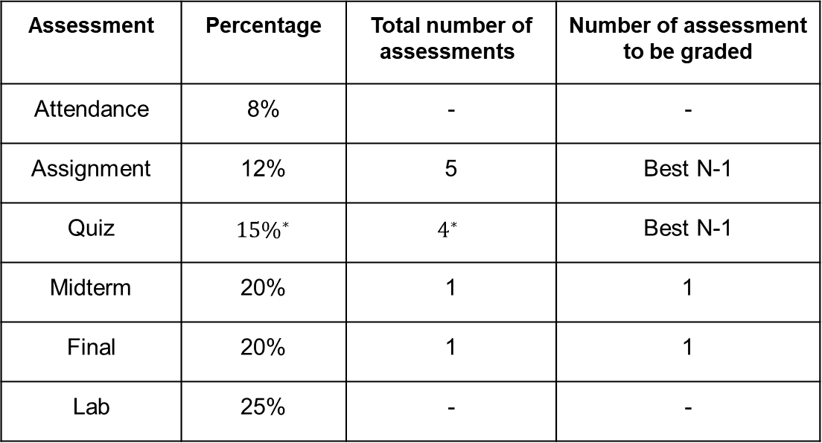
Marks Distribution
Assessment | Percentage | Total number of assessments | Number of assessment to be graded
Attendance | 8% | - | -
Assignment | 12% | 5 | Best N-1
Quiz | $$15\%^{∗}$$ | $$4^{∗}$$ | Best N-1
Midterm | 20% | 1 | 1
Final | 20% | 1 | 1
Lab | 25% | - | -
Percentage of Classes Attended | Marks
above 70 | 8
65-69 | 7.5
60-64 | 7
55-59 | 6.5
50-54 | 6
45-49 | 5
40-44 | 4
below 40 | 0
*I will take pop quizzes every now and then at the end or beginning of a class to be added as 2% bonus mark or as a “separate assignment”.
PS: Bonus will only be added to Assignment and Quiz marks. If you obtain the designated 27% in quiz and assignments, the bonus will not be added to other areas.

Slide 6
Quiz Schedule
Exam | Time | Date | Syllabus*
Quiz 1 | 3rd Week | 5 February | Lecture 1-4
Quiz 2 | 5th Week | 19 February | Lecture 5-8
Quiz 3 | 7th Week | 4 March | Lecture 9-10
Midterm | 8th Week | 8 March | Lecture 1-11
Quiz 4 | 10th Week | 27 March | Lecture 13-16
Quiz 5 | 14th Week | 22 April | Lecture 17- 19
Final | 15th Week | May 02, 2024 | Lecture 13-22

Slide 7
How to get an A/A+ in CSE251?
Time Management: Allocate 10 hrs/wk of regularly scheduled times in the week outside of class for CSE251:
30 min for reading of textbook / slides before each class
30 min for studying online notes before each class
30 min for studying these notes between classes
75 min for practicing problems (Check the practice sheet and previous questions).
4-5 hrs/wk for HWs / Assignments.
‒ In a semester, all lectures total only 30 hrs, which is less than 1 week at a job! It’s up to you to put in the time to learn
– Get a 1” binder (organize lecture notes/HWs/exams)
– Start assignments early. Do all problems by yourself first. If you get stuck, form study groups to work on problems together but ALWAYS write-up and submit YOUR OWN solutions. Do not blindly copy.
– Ask questions and come to office hrs if you get stuck. Don’t let confusion snowball.

Slide 8
How to get an A/A+ in CSE251?
• Practice doing problems. Get comfortable with the math manipulations and associated physical meaning, and you will find exam problems to be easier
– HW problems
– Example problems worked in lecture and online class notes
– Old exam problems
– Office hours
• Review your prerequisites.
– Node analysis, Mesh Analysis, Circuit solving techniques! CSE250
• Come to class!!
– HW & Participation are a significant part of your grade
– I will discuss topics to be emphasized on exams and give hints about how to approach the more difficult homework problems

Slide 9

How to get an A/A+ pass in CSE251?
• Attendance + Assignments + Quiz + Lab:
$8\% + 12\% + 25\% + 15\% =60\%$
- Suppose, you attend all the classes. Get 83% in Assignments, 83% in Lab, 75% in Quiz. So, you will get:
$$8+10+21+11.25=50.25\% ‼$$
- Try to do well in these continuous assessments and your road to passing CSE251 will be much easier.
• Come to class!!
– HW & Participation are a significant part of your grade
– I will discuss topics to be emphasized on exams and give hints about how to approach the more difficult homework problems

Slide 10
How to approach CSE251?
Write down important information. (See)
Visualize - Draw - doodle - interact (Imagine)
Think and solve. (Act)

Slide 11

First Day Survey

Slide 12
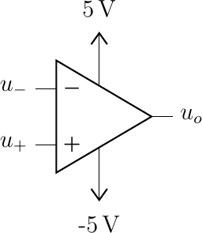

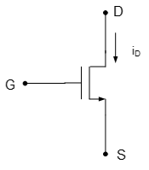
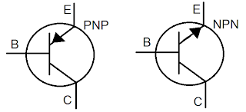
Course outline
Basically, study four types of devices. (Application centric usage)
OP-AMP
Diodes
MOSFET
BJT
Application: Amplification and Switching

Slide 13
Course Outcome
CO1
Understand and compare the characteristics and operation of electronic devices
CO2
Analyze electronic circuits made from these devices
CO3
Design various electronic circuits for power-generation and analog signal-processing applications.

Slide 14
A list of applications (non-exhaustive)
Switching
Rectifiers
Analog-to-digital (ADC)
Digital-to-analog conversion (DAC)
Arithmetic operations on analog Signals, e.g, summing, subtracting, exponentiation and generating voltage waveforms of different shapes.
Amplification
Regulators
Small-signal Amplifiers

Slide 15

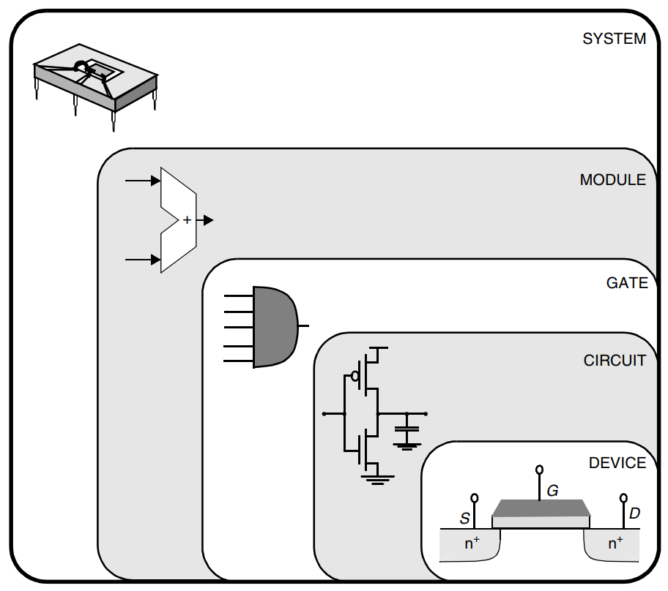
Abstraction Levels

Slide 16
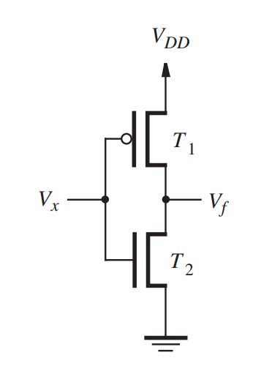
Logic gates –> Electronic Devices
Electronic Devices:
Transistors (BJT/MOSFET/ JFET/FinFET)
Diodes
Amplification and Switching
MOSFET realization of a NOT gate.
S. D. Brown and Z. G. Vranesic, Fundamentals of digital logic with Verilog design, Third edition. New York: McGraw-Hill Higher Education, 2014.

Slide 17
Historical Perspective
Mechanical gears
(1822 - Difference Engine, Analytical Engine)
Electrical switches and mechanical relays
(1944 - Harvard Mark 1 )
Has it always been like this?
Eras of Computer evolution:
Gen 1: Mechanical to Vacuum Tubes (17th -1940s):
Gen 2: Transistors (BJT) (1950s): Short-lived
Gen 3: Integrated Circuitry (1960s - Present)
(1951 – 1959)
Switchover to transistors from vacuum Tubes
VLSI
Microcomputers -> Laptops, Smartphones
WWI: 1914 - 1918
WWII: 1939 - 1945
History of Computers (uah.edu)

Slide 18
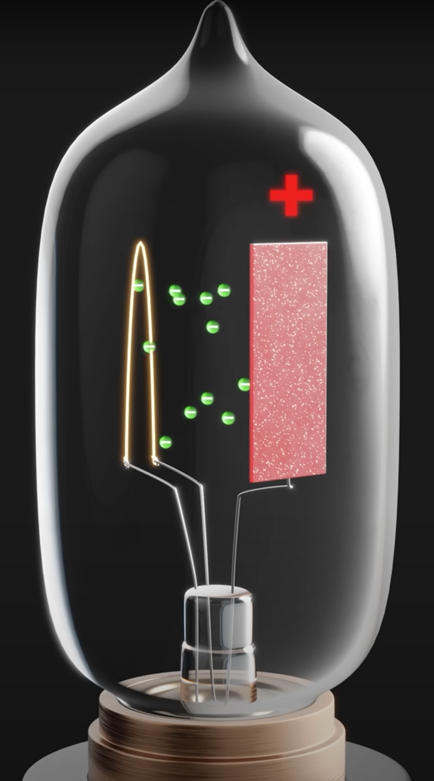
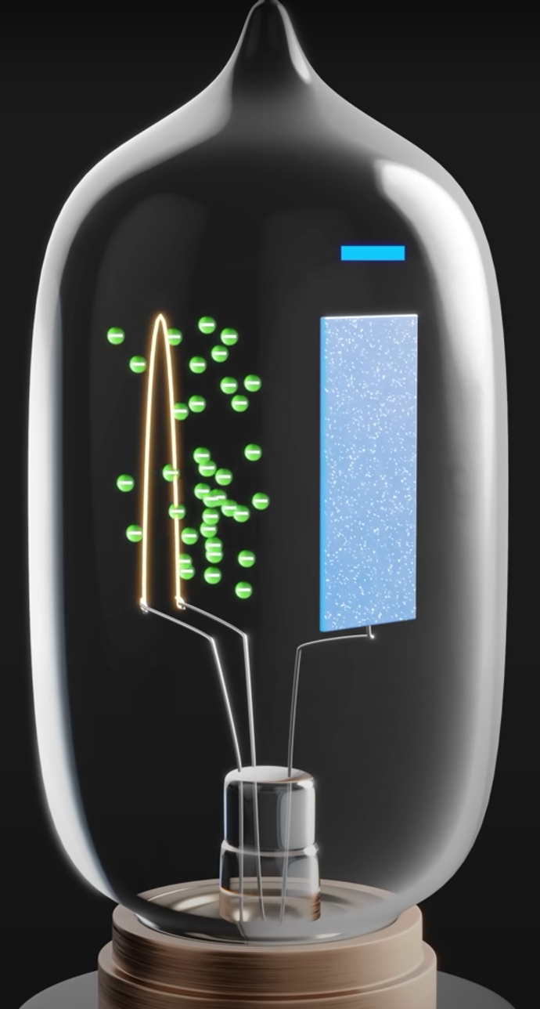
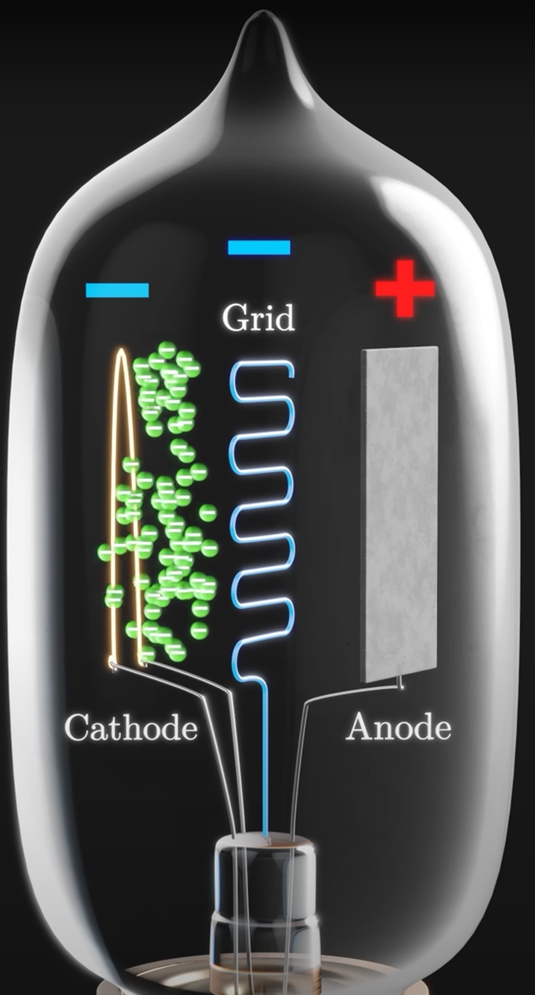
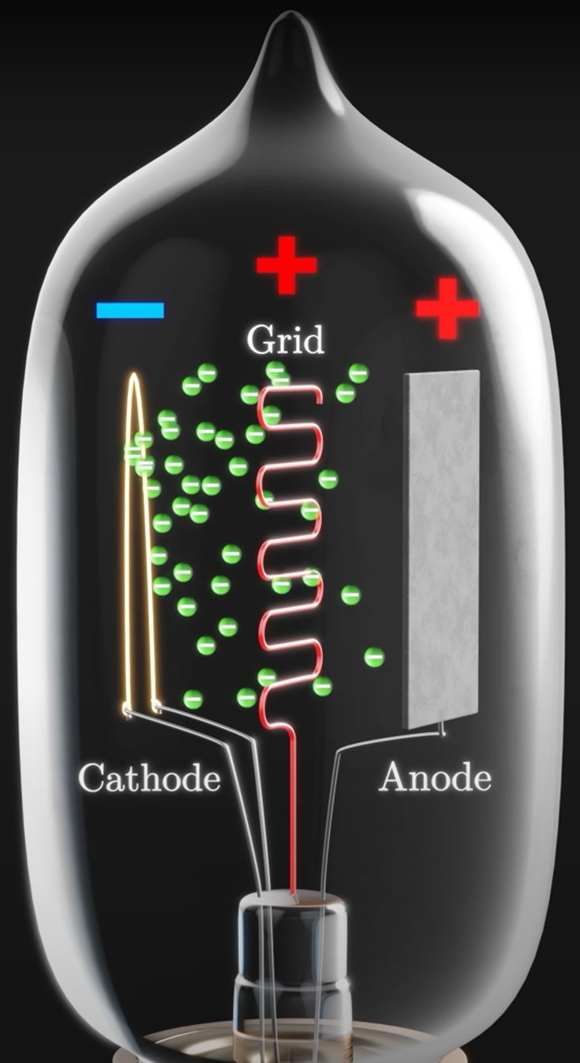
Vacuum Tubes (1946 - ENIAC)
Small changes in Grid voltage translate to
large voltages at the Anode
Electron Flow ON
Electron Flow OFF
Thermionic Diode
Thermionic Triode
SWITCHING
AMPLIFICATION

Slide 19
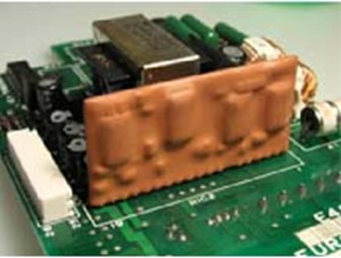
Computer Systems /Processors with BJT (60s)
Computer System | Year
IBM System/360 | 1964
DEC PDP Series | 1960 (PDP-1), 1965 (PDP-8), 1970 (PDP-11)
Control Data Corporation 6600 | 1964
IBM System/370 | 1970
Cray-1 | 1976
IBM System/360 hybrid BJT circuit

Slide 20
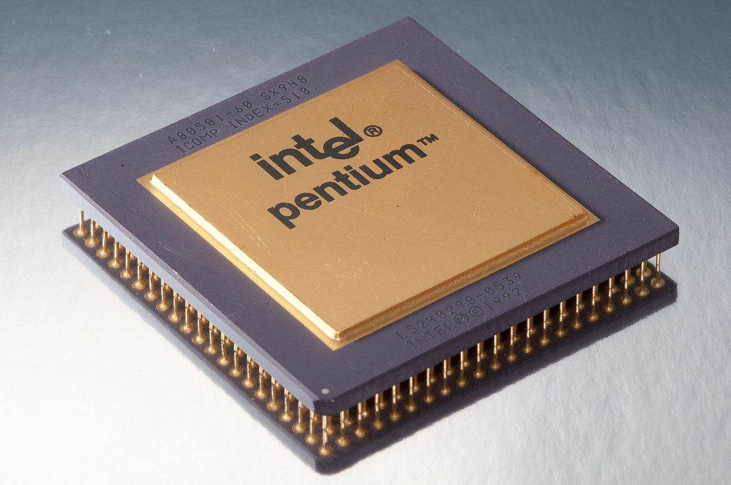
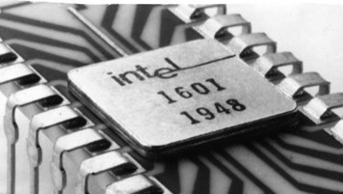
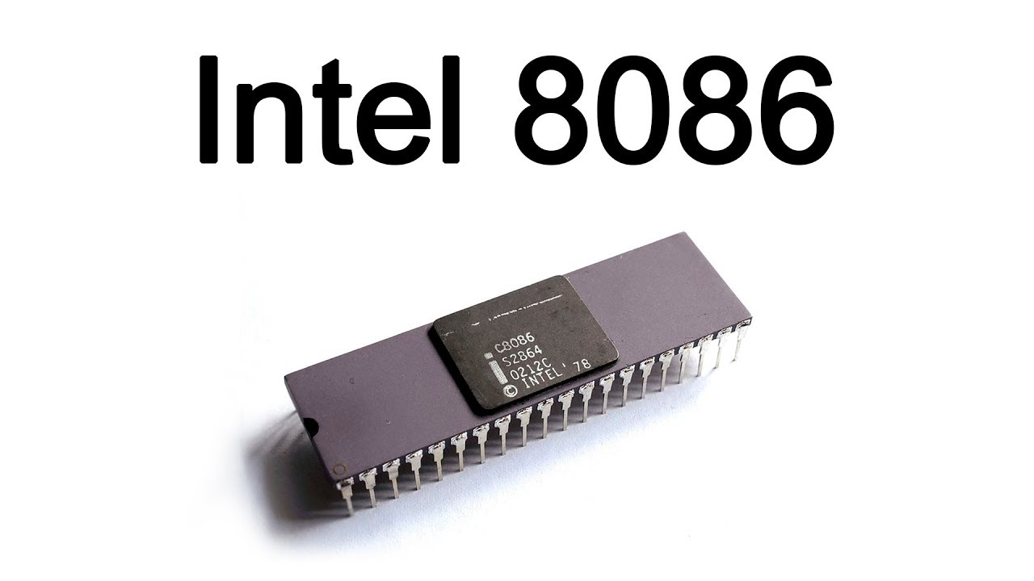

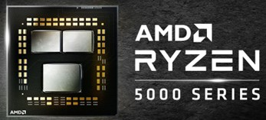

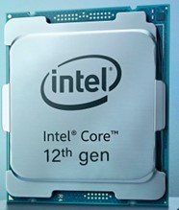


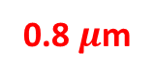
Processor evolution
Computer Systems /Processors with MOSFET (70s - Present)
0.8 $μ$m
Intel® Pentium®
1993
Intel® 4004
1971
22 nm
Intel ® 8086 1978
Intel® Core™
2010
7 nm
AMD Ryzen 5000
2021
10 $μ$m
3 $μ$m
Intel® Core™2 Duo
2006
Intel® Core™ 12th gen
2021
65 nm
10 nm
(Red: Feature size)

Slide 21
Moore’s Law
Moore’s Law
The number of transistors in a microchip doubles every two years

Slide 22
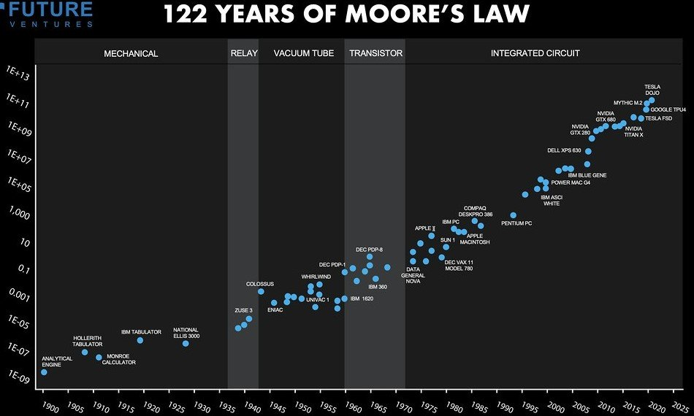
What Is Moore’s Law

Slide 23
Current scenario and the future
Ongoing chip shortage!
Two type of companies:
Fabless design companies: AMD
Apple etc.
Foundries: Intel
TSMC
Samsung
Global Foundries
Moore’s Law is approaching an end.
Possible alternatives for the future:
Spintronics
Photonics
Nano-electronics (Quantum)

Slide 24
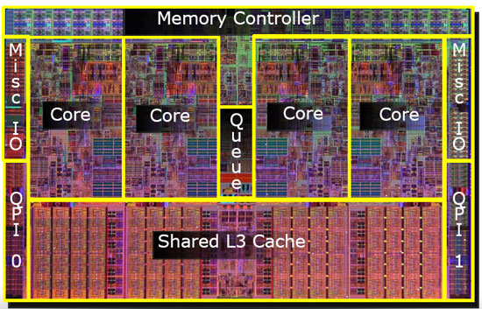
An Integrated Circuit Layout of a Processor

Slide 25
List of resources used in this slide
History of Computers
More about Vacuum Tubes – Veritasium YouTube
More information about Semiconductor chip industry
Moore’s Law

Slide 26
Thank You

